Slide 1
Juvenile Justice:
Investigating Racial Disparities
Researchers: Darcely Peña and Elsa Hritz

Slide 2
Table of Contents
01
02
06
03
07
Introduction
05
Results
Objectives
Conclusions
Dataset
Implications
04
Model

Slide 3
Introduction

Slide 4
Introduction
Previous Research Overview:
Builds on prior internship research with the Cumberland County Juvenile Probation Office
Key Findings: Youth from racially marginalized groups are disproportionally referred to juvenile probation and subject to harsher disciplinary actions
Current Study Focus:
Analyzes predictive patterns in juvenile referrals using socioeconomic factors
Examines associations between race and case characteristics among referred youth
Broader Goal:
Identify systematic patterns that may indicate structural bias within the juvenile justice system

Slide 5
Objectives

Slide 6
Objectives
Research Questions:
How do census tract-level characteristics such as racial composition and poverty levels relate to the number of juvenile probation referrals in Cumberland County?
Among referred juveniles, what demographic and case-related factors are most predictive of their race/ethnicity?
Objectives:
Estimate annual juvenile referral counts at the census-tract level in Cumberland County using socioeconomic characteristics to understand key drivers of juvenile justice involvement.
Predict the race of referred juveniles to identify demographic and case-related factors most strongly correlated with race in the juvenile justice system.

Slide 7
Our Dataset

Slide 8
Our Dataset
Pennsylvania Case Management System (2021-2022):
Case records of all juvenile referrals in Cumberland County including demographics, charges, and dispositions
2,319 referrals, 1,306 juveniles
US Census – ACS (2021-2022):
Datasets: Demographic & Housing Estimates, Selected Economic Characteristics, Selected Social Characteristics
Data collected on the census tract level in Cumberland County
Limitations:
2,719 expunged cases
Small sample sizes when analyzing individual census tracts

Slide 9
Data Cleaning
Predicting Referral Counts:
Matched arrest date to nearest reported address to determine residence
Merged cases and addresses table, filtered to juveniles living in Cumberland County
Grouped by census tract and year to count referrals
Merged with ACS census data for analysis
Predicting Juveniles' Race:
Removed missing values & unreliable columns
Merge case, disposed charges, and disposition tables
Each record represents a referral and its outcome
Selected only top 10 Offense Categories and relabeled the rest ”Other”
Dummy Data:
Categorical Columns: randomly assign value from list of unique entries
Numerical Columns: scaled by a randomly selected factor in a defined range

Slide 10
Models

Slide 11
Models
Predicting Juvenile Referral Counts:
Model: Random Forest Regression
Purpose: Predict referral counts at the census tract level in Cumberland County and identify societal factors associated with higher referral rates
Why Random Forest?
Captures nonlinear relationships between predictors
Reduces overfitting by averaging multiple decision trees
Provides feature importance to highlight key societal factors
Predicting Race of Referral Recipients:
Model: Random Forest Classification
Purpose: Classify the race of referral recipients and identify influential variables
Why Random Forest?
Handles imbalanced data (e.g., disproportionate race distributions)
Provides insights into variable importance and visualizes patterns across 100+ trees

Slide 12
Results

Slide 13
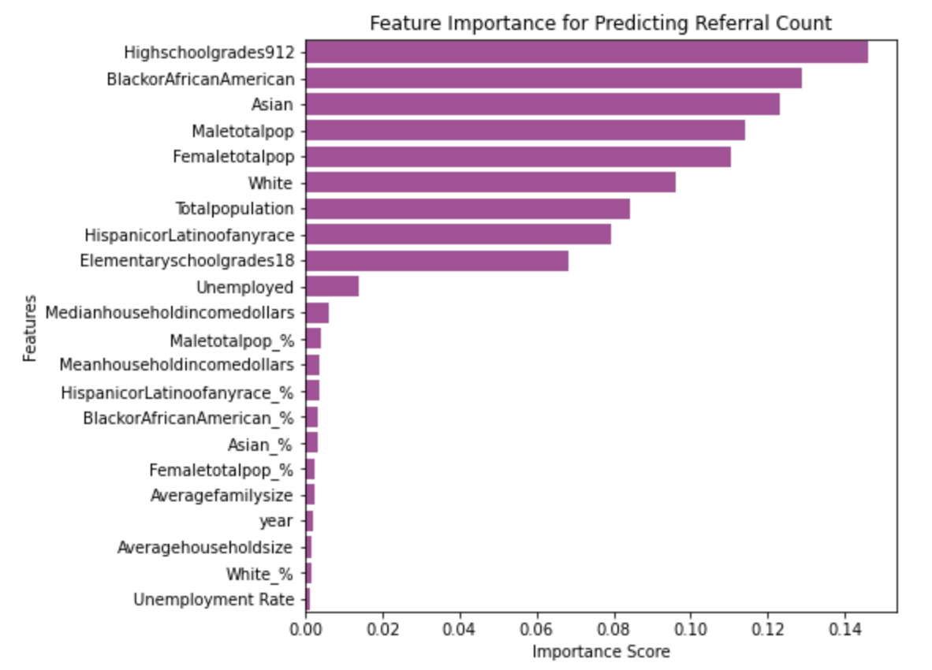
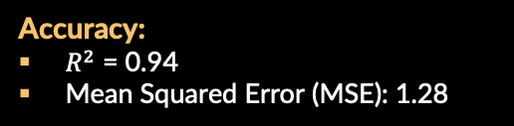
Predicting Juvenile Referral Counts
Accuracy:
$R^{2}$ = 0.94
Mean Squared Error (MSE): 1.28
Top Feature Importances:
Count of high schoolers (9-12)
Count of Black or African American residents
Count of Asian residents
Count of Male residents
Count of Female residents

Slide 14
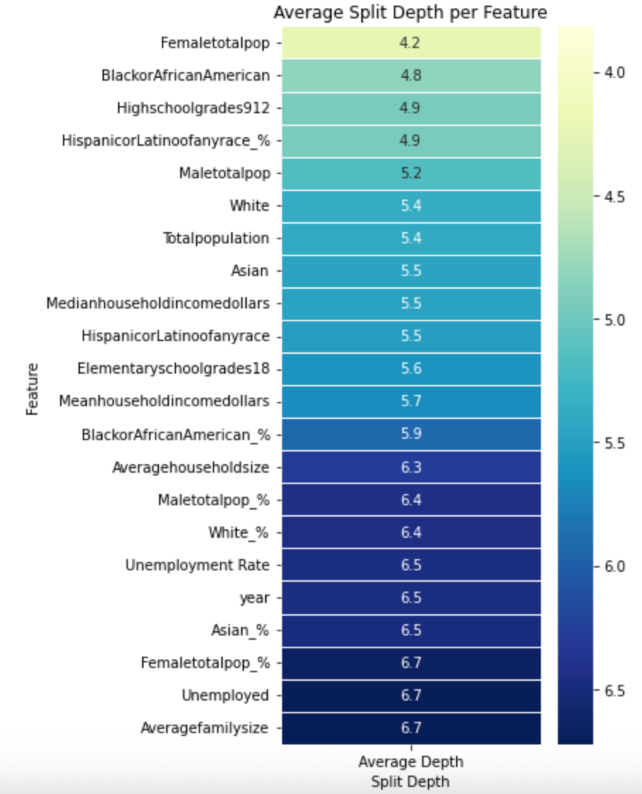
Predicting Juvenile Referral Counts
Features with Highest Average Split Depth:
Count of Female residents
Count of Black or African American residents
Count of high schoolers (9-12)
Count of Hispanic or Latino residents
Count of Male residents

Slide 15
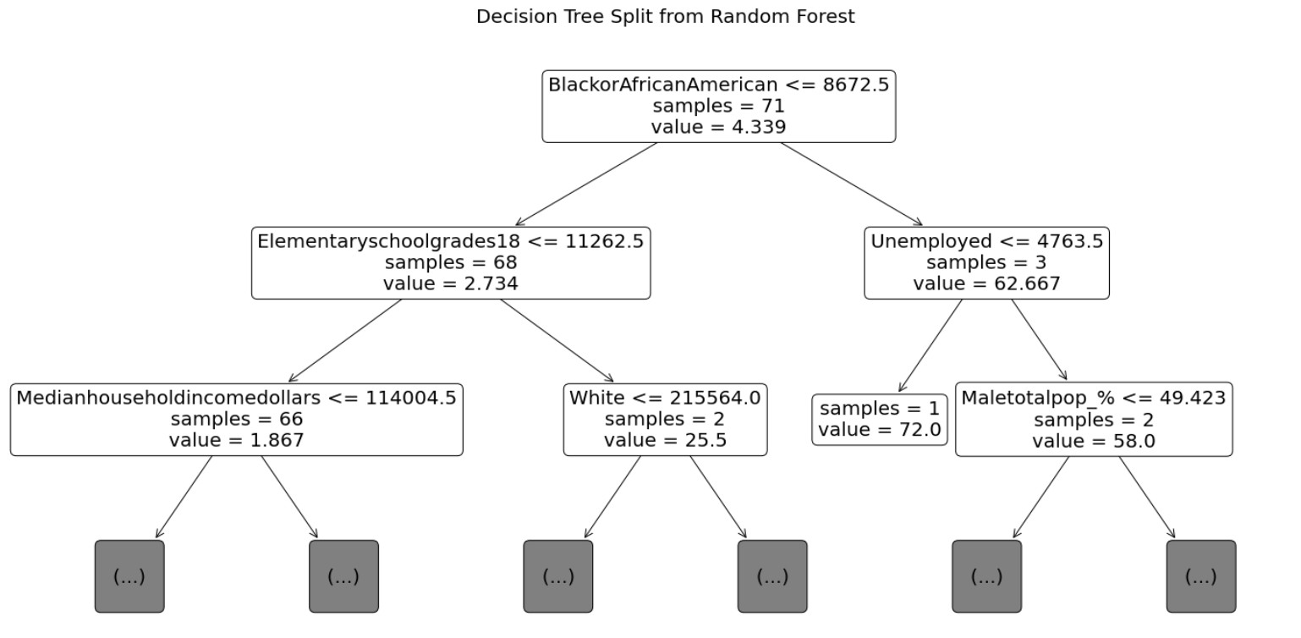
Predicting Juvenile Referral Counts

Slide 16
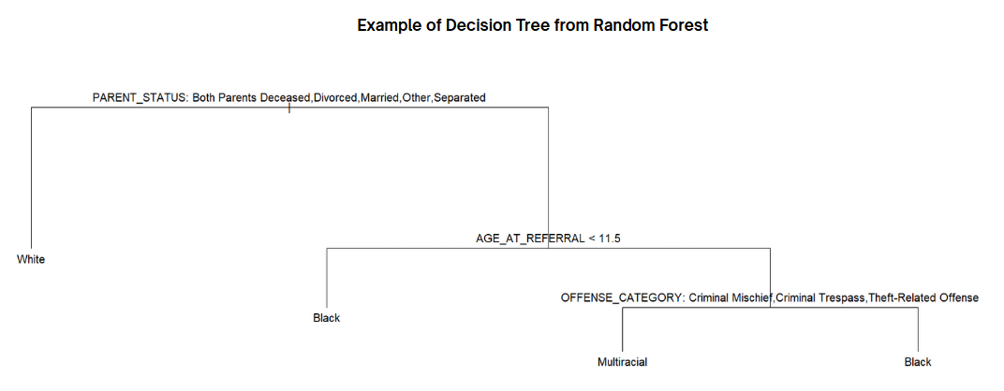
Predicting Race of Referral Recipients

Slide 17
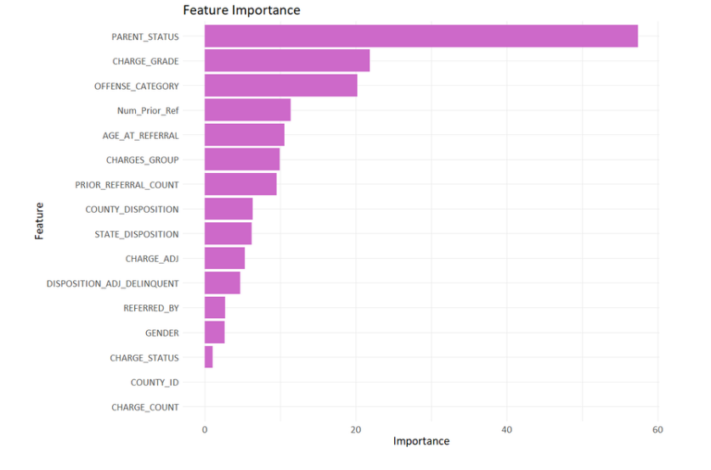
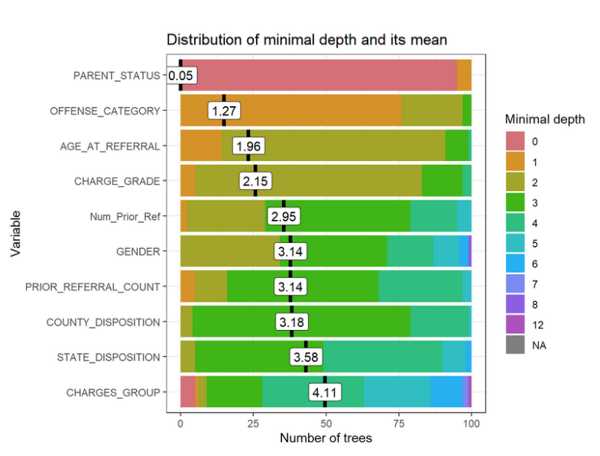
Predicting Race of Referral Recipients

Slide 18
Conclusions

Slide 19
Conclusions
Predicting Juvenile Referrals:
The strongest predictors of juvenile referrals are youth population size, racial composition, and gender distribution
While economic factors such as income and unemployment played a role, they were secondary to demographics in predicting referrals
The importance of racial and socioeconomic features suggests that systematic factors, not just individual behavior, plays a significant role in shaping who enters the juvenile justice system
Predicting the Race of a Referral Recipient:
Some of the strongest predictors of race in this analysis were factors not included in the judicial system
White referral recipients came from homes with both parents deceased, divorced, married, or separated
African American and multi-race recipients came from single parent homes
After parent status, age and type of offense were used to differentiate between the other races-indicating certain races follow patterns in their age and type of crime committed.
There may not be bias in the system, but this does demonstrate a difference between the types of backgrounds referral recipients have when grouped by race

Slide 20
Implications

Slide 21
Social, Ethical, and Legal Implications
Social
Ethical
Legal
Social services and community organizations can use this data to target interventions for at-risk youth.
Ethical concerns arise when differentiating risk factors based on race as it can reinforce stereotypes.
The information involves minors, requiring careful handling and protection. All researchers must be trained to ensure compliance with privacy laws and ethical standards.
Identifying a racial group as a factor in higher referral rates or crimes could further stigmatize that community.
Publishing information that reveals the identities of minors who have been referred to the juvenile justice system would violate their legal protections.
A strong correlation between race and referral rates may suggest discriminatory practices within the juvenile justice system that calls for legal reform.

Slide 22
Stakeholder Implications
Juvenile Justice System:
Need for systemic reform to address biases and ensure fair treatment across demographic groups, focusing on underlying social issues rather than just individual behavior.
Social Services and Community Organizations:
Opportunity to provide targeted support to at-risk youth, especially those from single-parent or economically disadvantaged homes, to prevent juvenile justice system involvement.
Policy Makers:
Push for policy reforms that address socio-economic and family-related factors contributing to juvenile referrals, ensuring more equitable treatment in the justice system.

Slide 23
Thank You!

